Slide 1
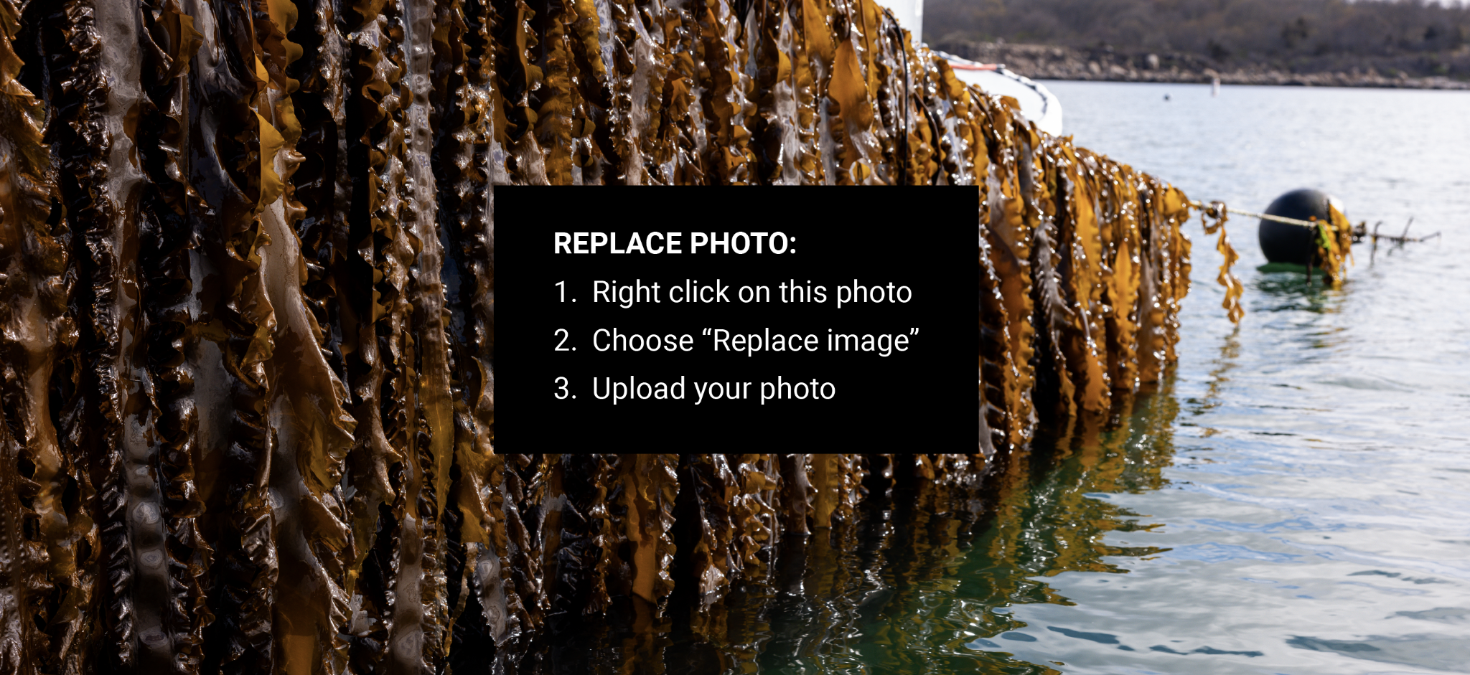
INGREDIENTS:
Text here
ALLERGENS:
Text here
FLAVOR PROFILE:
Text here
FORMAT:
Text here
SHELF LIFE:
Text here
HANDLING INSTRUCTIONS:
Text here
APPLICATIONS:
Text here
MEET THE FARMER
ABOUT YOUR OCEAN FARMER
Text here
Text here
Text here

